Slide 1
QCAA SENIOR
CHEMISTRY
AC9 YEARS 7–10
PHYSICS
BIOLOGY
STEM SIMULATION HUB
Free STEM Simulations,
Mapped to Your Curriculum
93 simulations · 176 AC9 descriptors · 66 QCAA senior units — one hub
Staff Presentation · 30 minutes
BUILT WITH CLAUDE CODE · ONGOING

Slide 2
BEFORE THE HUB
How This Actually Started
It wasn’t planned as a website — it grew, one frustration at a time.
1
Finding simulations
Started as a simple task — shortlist a handful of free simulations worth using in this presentation.
2
Mapping to the curriculum
Kept going: matched each one to the exact AC9 content descriptor it actually covered, tracked in a spreadsheet.
3
Spreadsheet → website
Hundreds of rows deep, tedious to update and no way to browse — not something anyone would want to search through. It needed to be a website.
4
Simulations alone weren’t enough
A matched simulation still wasn’t something you could hand a class — so a worksheet became part of every listing.
5
Not every simulation had one
Missing worksheets were generated — curriculum-mapped, sized to a lesson, clearly labelled as AI-made.
6
Some descriptors had no simulation at all
Where nothing good existed anywhere online, four were built from scratch to fill the gap.
And here we are — a curriculum-mapped hub with 93 simulations, 176 AC9 descriptors and 66 QCAA units. Still evolving the same way it started: one gap at a time.
2

Slide 3
WHY THIS EXISTS
Finding a good, curriculum-matched
simulation takes too long
!
Hours of searching
PhET, GeoGebra, Desmos, Javalab, university labs — good simulations are scattered across dozens of separate sites.
“I just want to know—
which simulation covers
this exact content
descriptor, right now.”
!
No curriculum link
A simulation being “good physics” doesn’t tell you which AC9 content descriptor or QCAA unit it actually satisfies.
— every teacher, ever
!
Uneven quality
Some sims are excellent, some are broken, outdated, or the wrong year level — hard to tell without trying each one.
STEM Simulation Hub answers that directly — search or browse by the curriculum itself, not by guesswork.
3

Slide 4
PURPOSE
One Hub, Mapped Directly to What You Already Teach
Not tagged by subject — mapped to the exact descriptors and units on your work program.
AC9 · YEARS 7–10
QCAA · SENIOR 11–12
176
66
content descriptors, Year 7 through Year 10
syllabus units & options, across 15 subjects
Mathematics — 101 descriptors
Mathematics — 5 subjects
Measurement 23
Algebra 21
Statistics 17
Number 16
General Maths
Methods
Specialist
Essential
Numeracy
Space 14
Probability 10
Science — 10 subjects
Science — 75 descriptors
Biology
Chemistry
Physics
Psychology
Marine Science
Science Inquiry 32
Understanding 27
Human Endeavour 16
Earth & Env. Science
Agricultural Science
Every strand, every year level — not just the popular topics.
Agricultural Practices
Aquatic Practices
Science in Practice
General, Applied and Short Course syllabuses all included.
4

Slide 5
WHAT THIS LOOKS LIKE FOR YOU
From Curriculum Code to Classroom
A real descriptor, followed all the way through to a lesson you could teach tomorrow.
AC9M10M03
Year 10 · Measurement
A 50-MINUTE LESSON, BUILT AROUND IT
“Solve practical problems applying Pythagoras’ theorem and trigonometry of right-angled triangles, including problems involving direction and angles of elevation and depression.”
5 min
Hook
Show the fixed-hypotenuse triangle. Ask: will the ratios change if I resize it?
↓
15 min
Explore
MATCHED SIMULATION
Pairs drag the angle slider, log SOH–CAH–TOA values as the angle changes.
SimuPhysics — Right-Triangle Ratio Simulator
10 min
Formalise
Keeps the hypotenuse fixed while students resize the triangle — showing sine, cosine and tangent depend only on the angle, not the triangle’s size.
Connect the pattern back to Pythagoras’ theorem and the three trig ratios.
↓
15 min
Practice
READY WORKSHEET
AI worksheet: elevation and depression word problems, same descriptor.
“Sine, Cosine and Tangent: Ratios Not Sizes” · ≈ 30 min · Year 10
5 min
Exit ticket
One right-triangle problem — find the missing angle or side.
5

Slide 6
NAVIGATION
Three ways in — pick the one that matches
how you're planning
7–10
QCAA
≡
Years 7–10 Hub
Senior Syllabus Hub
Browse by Topic
index.html
senior.html
topics.html
Filter by subject, year level, strand — or jump straight to one AC9 code, like AC9M10M03.
Narrow by learning area, syllabus type, subject, then the exact unit or option you're teaching.
Every simulation, grouped by field (Physics, Algebra...) or by provider — no curriculum needed.
BEST FOR: PLANNING A SPECIFIC AC9 LESSON
BEST FOR: PLANNING A SENIOR QCAA UNIT
BEST FOR: EXPLORING BROADLY, OR BY SOURCE
6

Slide 7
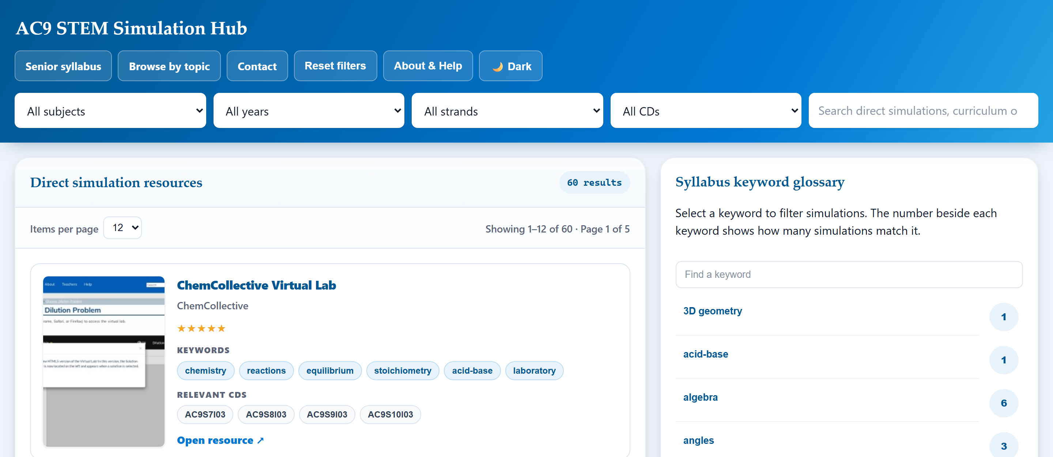
WALKTHROUGH · INDEX.HTML
Years 7–10 Hub
✓
Filter by subject, year & strand
Combine freely — selecting just a subject still shows every relevant Year 7–10 result.
✓
Or jump straight to one descriptor
Search “AC9M10M03” and see only what matches that exact code.
✓
A live keyword glossary
Sidebar counts how many simulations match each curriculum term, updating as you filter.
✓
Click any keyword or CD chip
On a card, or on a simulation's own page — always jumps back here, filtered.
7

Slide 8
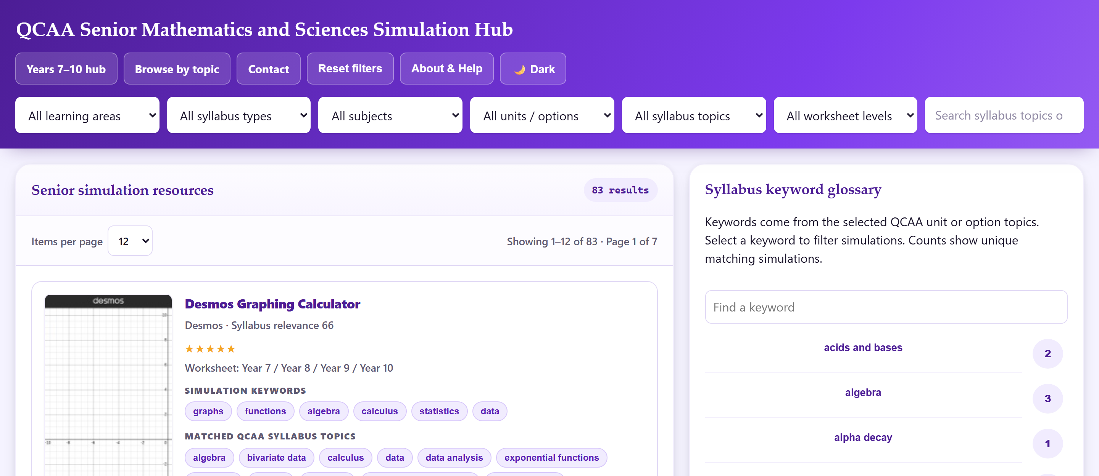
WALKTHROUGH · SENIOR.HTML
Senior Syllabus Hub
✓
Narrow the QCAA way
Learning area → syllabus type → subject → unit/option → topic (e.g. “trigonometric functions”).
✓
Filter by worksheet year level
See only simulations whose worksheet suits Year 7–8, 9–10, or Senior 11–12.
✓
Ranked by syllabus relevance
Best-matching resource for the unit shown first, not just alphabetical.
✓
A senior list, not a junior copy
Shared resources appear here with QCAA-specific matched topics only.
8

Slide 9
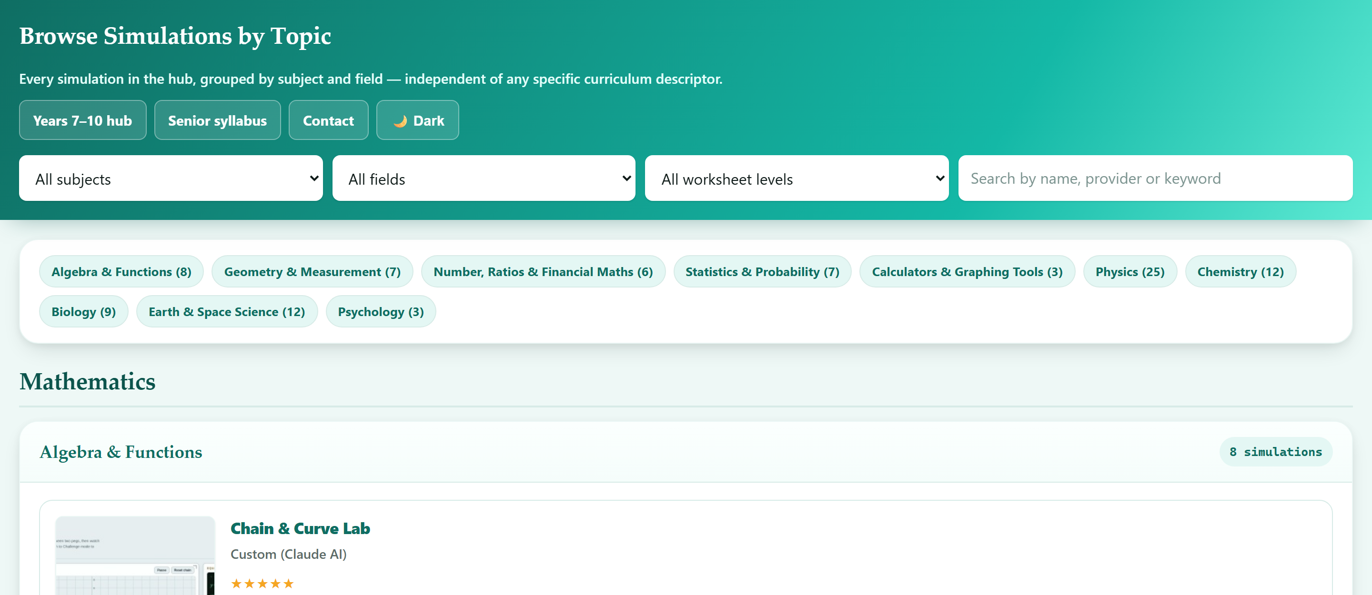
WALKTHROUGH · TOPICS.HTML
Browse by Topic
✓
Independent of any one descriptor
Grouped by field — Physics, Chemistry, Algebra & Functions, Statistics & Probability, and more.
✓
Click a provider to see its full set
Every card's source (PhET, GeoGebra, Desmos...) is a link — see everything from that provider instantly.
✓
Good for cross-year planning
See every simulation touching a field before you commit to a specific descriptor.
✓
The whole library, deduplicated
Every simulation from both hubs, in one list, each shown once.
9

Slide 10
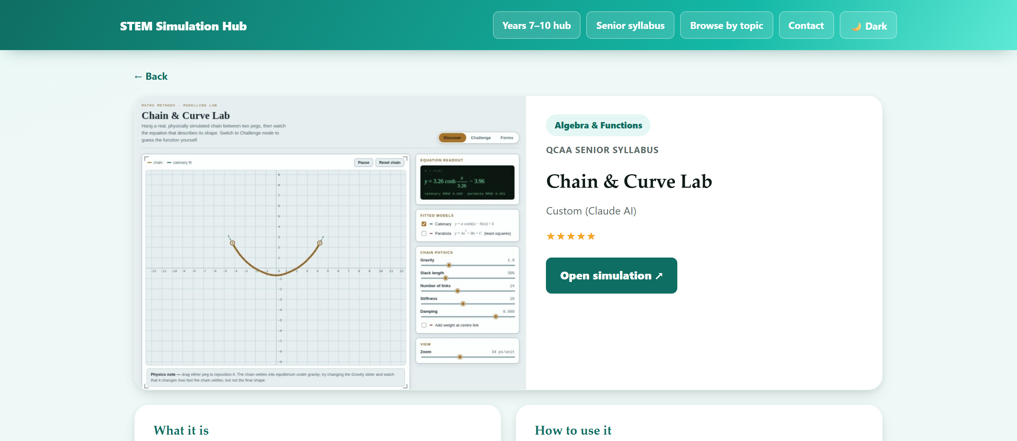
WALKTHROUGH · SIMULATION.HTML
Inside a Simulation Page
✓
A screenshot, description & “how to use it”
Every one of the 93 simulations has hand- or AI-written classroom guidance — not just a bare link.
✓
The QCAA topic tag is right there
“Algebra & Functions” here — confirms it before you click through.
✓
Every chip links back to the hubs
Keywords, AC9 descriptors and QCAA topics all jump to a pre-filtered hub page.
✓
Recommended worksheet, right there
Preview in-page or download — see “Worksheets” next.
10

Slide 11
EVERY SIMULATION, READY TO TEACH WITH
Worksheets: Real — or AI, Always Available
PRIMARY
SECONDARY
Sourced from the provider
AI-generated, ≈ 30 minutes
Where the simulation's own publisher (PhET, university labs, education agencies) offers a real worksheet or teacher guide, that's shown first — verified, not guessed.
Every simulation — with or without a real worksheet — also gets a curriculum-mapped task sheet, sized to fill a lesson, generated and reviewable in-page.
45
93
of 93 simulations
of 93 simulations — 100%
⚠ AI-generated worksheets are clearly labelled on every page — always review before handing to students.
11

Slide 12
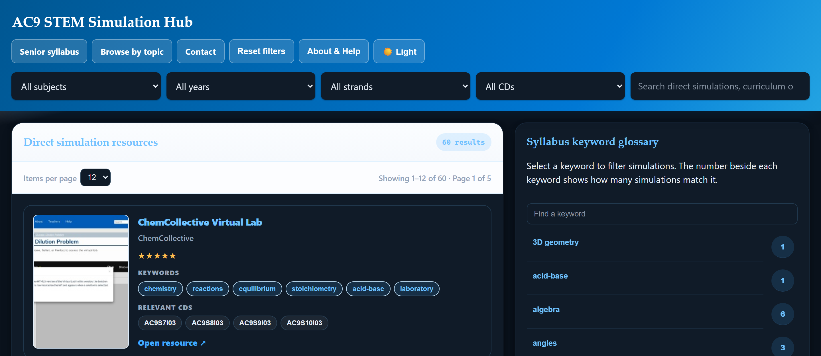
ACCESSIBILITY
One click for a full light ↔ dark theme
☀ Light
☾ Dark
Every page, every card, every form field and admin panel — not just a colour swap. Remembers your choice next visit.
12

Slide 13
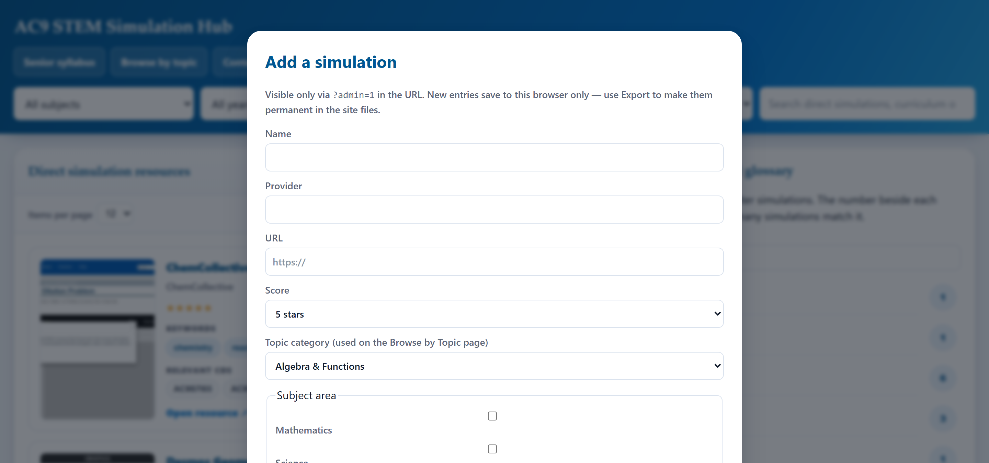
FOR SITE ADMINS
Found a Simulation? Add It Yourself
1
Open with ?admin=1
A hidden “+ Add simulation” button appears — invisible to regular visitors.
2
Paste the name & URL
Keyword tags are auto-suggested by matching against the same curriculum vocabulary the whole site uses.
3
Review, then save
Nothing is added automatically — you confirm or adjust the suggested tags and category first.
4
Export to make it permanent
Saved locally in your browser until you export the generated code back into the site.
13

Slide 14
WHEN NOTHING FREE & GOOD EXISTED
Four Simulations, Built From Scratch
Some QCAA gaps had no decent free simulation anywhere — so these were built directly, in the same conversational workflow as the rest of the site.
✦
✦
✦
✦
Chain & Curve
DC Circuits &
Ohm's Law
Heating
Processes
Ionising Radiation
& Nuclear Reactions
Maths Methods — catenary vs. parabola, live curve-fitting
Physics — series/parallel circuits, voltmeter & ammeter probes
Physics Unit 1 — heating curves, thermal equilibrium, black-body radiation
Physics Unit 1 — decay, half-life, shielding, fission & fusion
14

Slide 15
HOW THIS ACTUALLY GETS BUILT
Built With Claude Code
Every filter, every fix, every new simulation on this site was built through plain-language conversation — then tested and deployed the same session.
1 Ask
2 Build & test
3 Ship
Describe what's needed in plain English — a feature, a bug, a new simulation to map.
Claude Code writes it, opens the real site in a browser, and checks it actually works.
Pushed straight to this live, free GitHub Pages site — no separate release process.
THIS WEEK, FOR EXAMPLE
A routine usability pass — done as part of preparing this presentation — found that AC9M10M03 (the trigonometry descriptor from slide 5) was missing its own keyword, so the site's tag-matching couldn't find it. Fixed and pushed live the same day. That's the normal rhythm: this is a living site, not a one-off release.
15

Slide 16
ROADMAP
This Is Version Now, Not Version Final
Curriculum gap analysis already flags exactly what's still thin — that becomes the next thing built:
Mathematical Methods
derivatives · integration · surds
Specialist Mathematics
combinatorics
Physics
the standard model (Unit 4)
General Mathematics
sequences · investing & annuities
Plus: more bespoke Claude-built simulations where free options fall short, continued worksheet coverage, and ongoing usability passes like the one behind this deck.
16

Slide 17
THIS ONLY GETS BETTER WITH YOUR INPUT
Get Involved
→
Found a good simulation?
Send it through the Contact page, or add it yourself via the admin panel.
→
Spot something broken?
A dead link, a wrong mapping, a display glitch — flag it and it gets fixed, usually the same week.
→
Have a gap in mind?
Tell us which AC9 descriptor or QCAA unit still has nothing good — it goes straight onto the roadmap.
hjkim0@eq.edu.au · or the Contact page on the site
Feedback shapes what gets built next.
17

Slide 18
Thank you.
Questions — or things you'd like to see added?
HKIM2804-BEEP.GITHUB.IO/STEM-SIMULATION-HUB
Free · no login · updated continuously
18

